Slide 1
Chapter 6(2): Process Synchronization
Apr, 2024

Slide 2
Chapter 6: Process Synchro
Race condition and critical section problem
Synchronization Hardware
Mutex Locks
Semaphore
Process Synchronization Problems

Slide 3
Objectives
To present hardware solutions of the critical-section problem
To explore several tools that are used to solve process synchronization problems
Mutex lock
semaphoare
To examine several classical process-synchronization problems

Slide 4
Limitations of Spinlock（自旋锁）
Busy waiting
不断循环等待浪费了cpu周期，这原本可以用于其他进程
优点是没有context switching，

Slide 5
Synchronization of A and B
Process A
print(“A”)
Process B
print(“B”)
A and B run concurrently

Slide 6
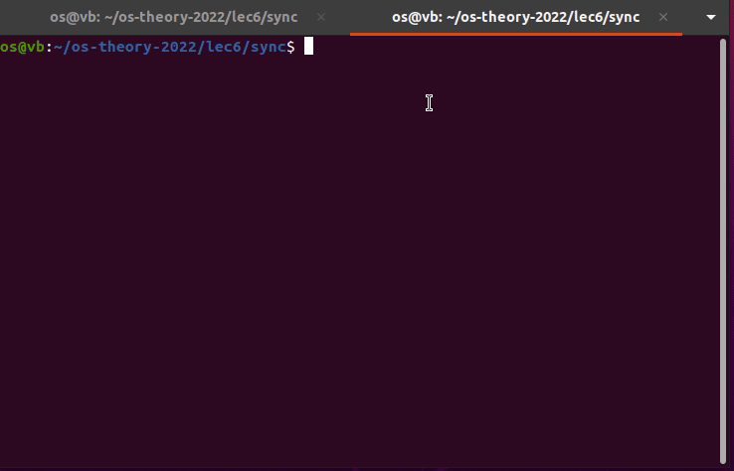
Demo
Notes:
两个线程打印A和B，出现了错序

Slide 7
Synchronize A with B
A
B
A
B
A
…
How to?

Slide 8
AB
print “A”
print “B”
print “A”
print “B”
print “A”

Slide 9
ABC
Process A
print(“A”)
Process B
print(“B”)
Process C
print(“C”)
A and B and C run concurrently

Slide 10
Synchronize A with B and C
A
B (C)
C (B)
A
B (C)
C (B)
…
How to?

Slide 11
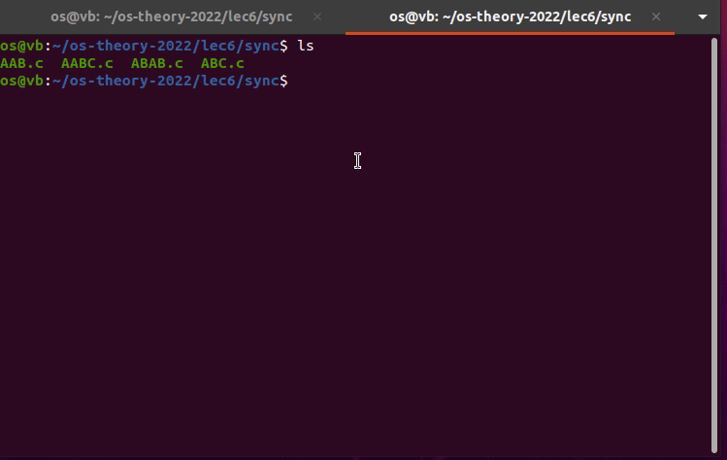
Demo

Slide 12
ABC
print “A”
print “C”
print “B”
print “A”
print “C”
print “B”
print “A”

Slide 13

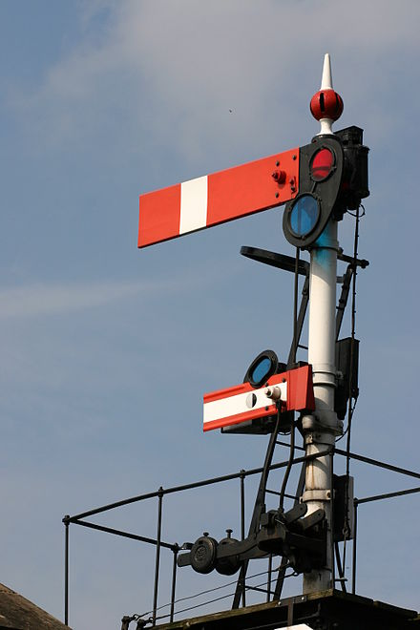
Semaphore
Dijkstra

Slide 14
Semaphore
Semaphore S – integer variable
Two standard operations modify S:
wait() and signal()
Originally called P() and V()
Proberen: test
Verhogen: increment
Notes:
proberen: 检测
verhogen: 增量

Slide 15
Implementation of Semaphore
wait(S)
{
while(S <= 0); // busy wait
S--;
}
signal(S)
{
S++;
}
Problem??
Notes:
proberen: 检测
verhogen: 增量
Problem: busy wait and critical section

Slide 16
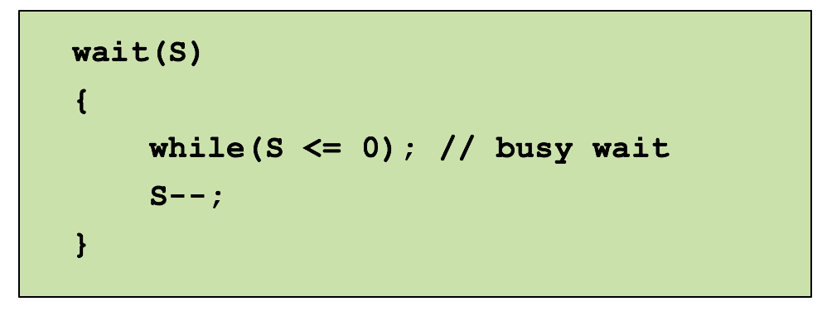
Semaphore with busy waiting
Notes:
Problem: busy wait and critical section

Slide 17
Semaphore with no Busy Waiting
typedef struct
{
int value;
struct process *list;
} semaphore;
#resources
#waiting-processes

Slide 18
Semaphore with no Busy Waiting
wait(semaphore *S)
{
S->value--;
if(S->value 0)
{ add this process to S->list;
block();
}
}
<
Notes:
进入信号量等待队列，进入blocking，将线程空出来

Slide 19
Semaphore with no Busy Waiting
signal(semaphore *S)
{
S->value++;
if(S->value 0)
{ remove a process P from S->list;
wakeup(P);
}
}
<=

Slide 20
Semaphore with no Busy Waiting
With each semaphore there is an associated waiting queue
Two operations:
block – place the process invoking（） the operation on the appropriate waiting queue
wakeup – remove one of processes in the waiting queue and place it in the ready queue

Slide 21
Semaphore Implementation
Must guarantee that no two processes can execute wait() and signal() on the same semaphore at the same time
Thus, implementation becomes the critical section problem where the wait and signal code are placed in the critical section
wait(semaphore *S)
{
S->value--;
if(S->value < 0)
{ add this process to S->list;
block();
}
}
atomic
Notes:
这里是先自减之后判断是否小于0，若小于则说明原本就没有可用资源，那么进入阻塞，等待可用资源（从-1到0）
这样允许进程提前排队等待，释放cpu，而不是busy wait一直占用cpu。

Slide 22
Semaphore Implementation
Must guarantee that no two processes can execute wait() and signal() on the same semaphore at the same time
Thus, implementation becomes the critical section problem where the wait and signal code are placed in the critical section
Hardware instruction
signal(semaphore *S)
{
S->value++;
if(S->value <= 0)
{ remove a process P from S->list;
wakeup(P);
}
}
atomic
Mutex lock
Semaphore
Notes:
先自增，如果自增后还是小于0或者等于0，则说明有人在提前排队等待资源，此时从一个等待的进程从等待队列中移除。
也就是先处理完等待队列的，等待队列没有了才会来一个处理一个。

Slide 23
Demo of AB
A
B
A
B
…

Slide 24
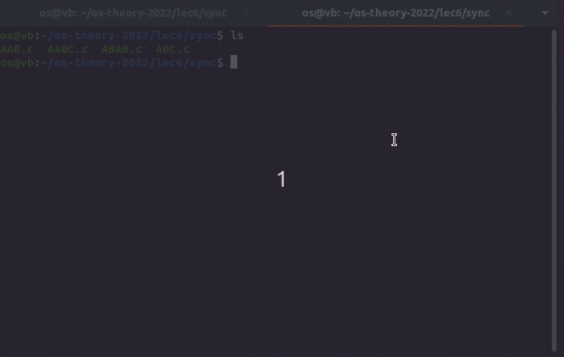
Demo of AB

Slide 25
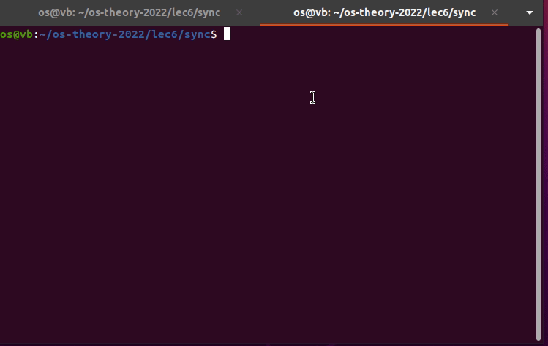
Demo of AB

Slide 26
Demo of ABC
A
B
C
A
C
B
A
B
C
…

Slide 27
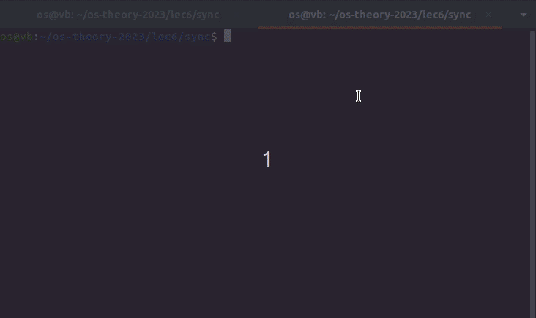
Demo of ABC
Notes:
How to use three semaphores?
A: signal(B);signal(C);wait(A);wait(A)
B: wait(B);signal(A)
C: wait(C);signal(A)

Slide 28
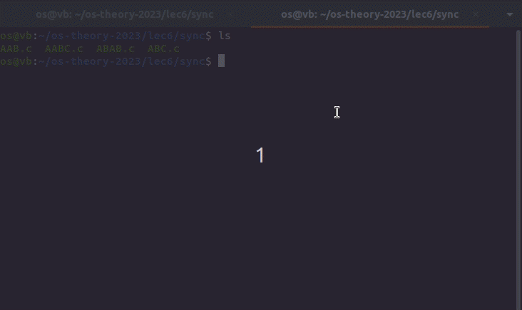
Demo of ABC

Slide 29
Question?
How to get ABC always?
用3个
A: print; signal(B); signal(C); wait(A); wait(A)
B: wait(B); print; signal(A)
C: wait(C); print; signal(A)
用4个
A: print; signal(A1); signal(A2); wait(B); wait(C)
B: wait(A1); print; signal(B)
C: wait(A2); print; signal(C)

Slide 30


Semaphore Type
Binary semaphore
Integer value can not exceed 1
Then a mutex lock for mutual exclusion
Must be initialized to 1
Counting semaphore
Integer value can range over an unrestricted domain

Slide 31
Mutex Lock vs. Semaphore
Scenarios
Contention: critical section
Cooperation: synchronization, resources
Operations
acquire/release (release->acquire??)
wait/signal, P/V
Same or different processes
Initialization
unlocked (two values, locked or unlocked)
0,1,2,…,n
Implementation
Hardware instruction
Wait queue (spinlock, busy waiting)
Binary semaphore used as mutex lock
Initialized to 1

Slide 32
Synchronization Problems

Slide 33
Classical Problems of Synchronization
Classical problems used to test newly-proposed synchronization schemes
Producer-Consumer Problem
Readers and Writers Problem
Dining-Philosophers Problem

Slide 34
The Use of Synchronization Tools
What problem
Identify shared resources, race condition, and critical section
Identify number of resources
Identify synchronization points
Which tool
Mutex lock, semaphore, and others
Busy waiting or suspending
Duration of critical section
Context switch cost
How to initialization
Number of resources
Binary semaphore
Mutex lock

Slide 35
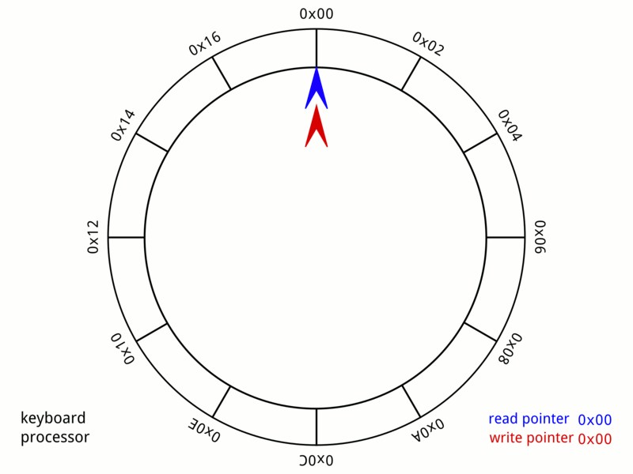
Circular Buffer
https://en.wikipedia.org/wiki/Circular_buffer
Notes:
HELLOWIKIPEDIA

Slide 36
Identify Race Condition and Cooperation
Bounded-buffer problem 有界缓冲问题
Producer-consumer problem
https://en.wikipedia.org/wiki/Circular_buffer
Notes:
Difficulty: multiple producer and consumer

Slide 37
Producer-Consumer Problem (1)
count = 0;
producer
consumer
while(true)
{ while(count == BUFFER_SIZE);
count++;
}
while(true)
{
while(count == 0);
count--;
}
Problem?
Notes:
没有互斥锁，不互斥

Slide 38
Producer-Consumer Problem (2)
count = 0;
lock = 1;
producer
consumer
while(true)
{ while(count == BUFFER_SIZE);
wait(lock);
count++;
signal(lock);
}
while(true)
{
while(count == 0);
wait(lock);
count--;
signal(lock);
}
Problem?
Notes:
While循环造成的Busy waiting，如果用sleep函数让进程suspended呢？

Slide 39
Producer-Consumer Problem (3)
count = 0;
lock = 1;
producer
consumer
while(true)
{ if(count == BUFFER_SIZE)
sleep();
wait(lock);
count++;
signal(lock);
if(count == 1)
wakeup(consumer);
}
while(true)
{
if(count == 0)
sleep();
wait(lock);
count--;
signal(lock);
if(count == BUFFER_SIZE-1)
wakeup(producer);
}
count=1
2 consumers
Problem?
Notes:
Multiple producer or consumer: eg. 1 producer, 2 consumers, and count == 1.
Then two consumers both test and succeed.
If two producers and 1 consumer, and count == 0. Two producers produce 2, but only one is wake up.
Problem: lost signal / empty test fail

Slide 40
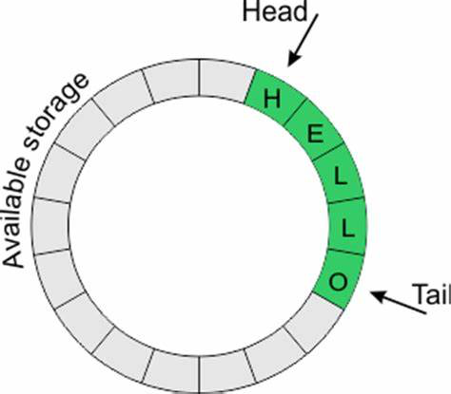
Producer-Consumer Problem ()
n buffers, each can hold one item
Semaphore lock initialized to the value 1
Semaphore full initialized to the value 0
Semaphore empty initialized to the value n
producer
consumer
do{
wait(empty);
wait(lock);
count++;
signal(lock);
signal(full);
}while(true);
do{
wait(full);
wait(lock);
count--;
signal(lock);
signal(empty);
}while(true);
Notes:
如果缓冲区满了，也就是empty=0，那么producer等待consumer signal一个empty
如果缓冲区空了，也就是full=0，那么consumer等待producer signal一个full

Slide 41
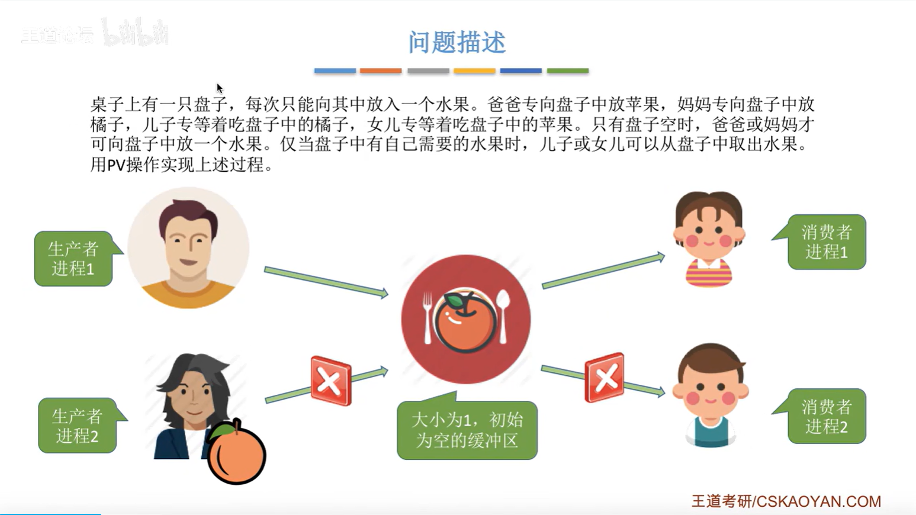
Multiple producer Multiple consumer
Notes:
多生产者多消费者，每个生产者生产不同种类的东西，每个消费者消费不同种类的东西
这个题的缓冲区为1。

Slide 42
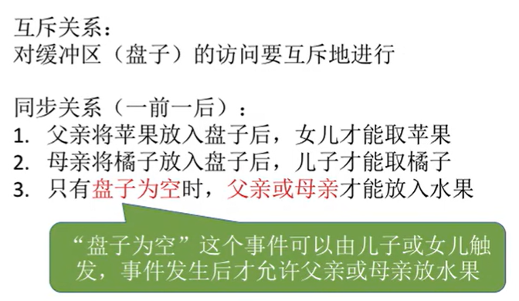

Slide 43
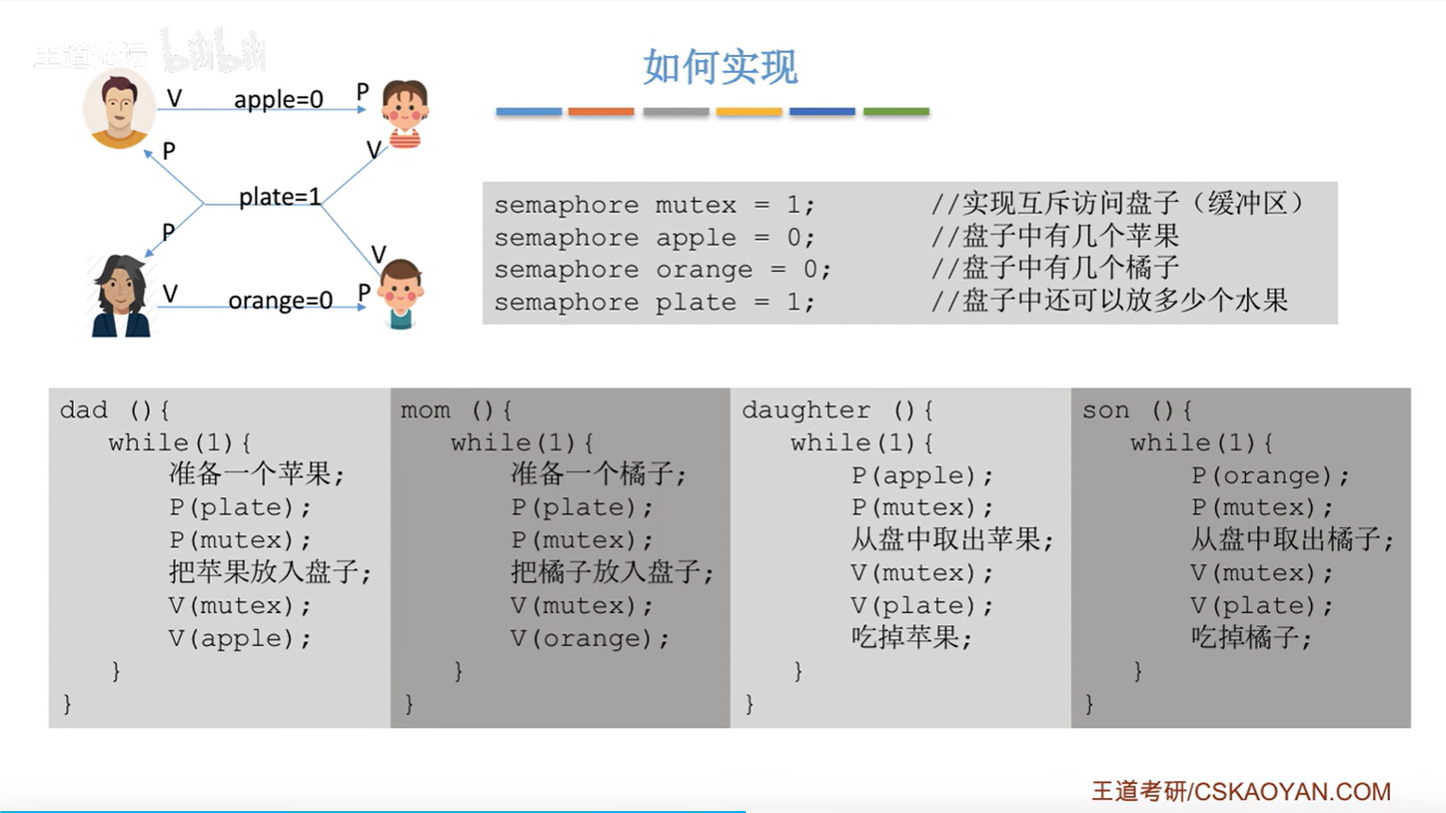

Slide 44
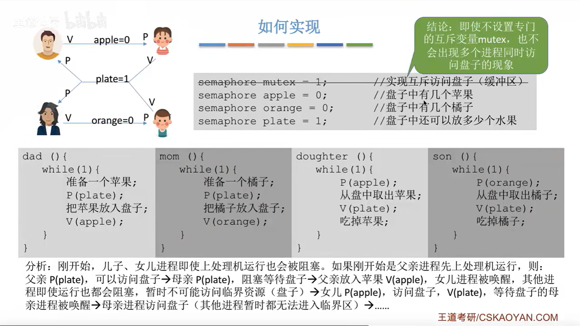
Notes:
如果说缓冲区大于1，那么就必须要设置mutex，

Slide 45
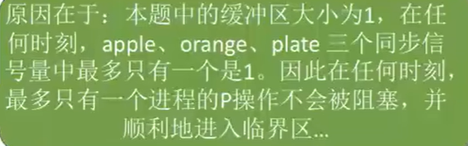

Slide 46
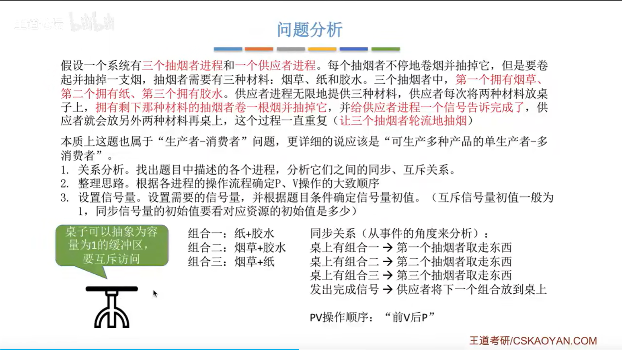
吸烟者问题
Notes:
一个生产者可以生产多种产品。
由于生产者的下一次生产是吸烟者通知的，所以桌子上最多有一个产品，即缓冲区大小为1

Slide 47
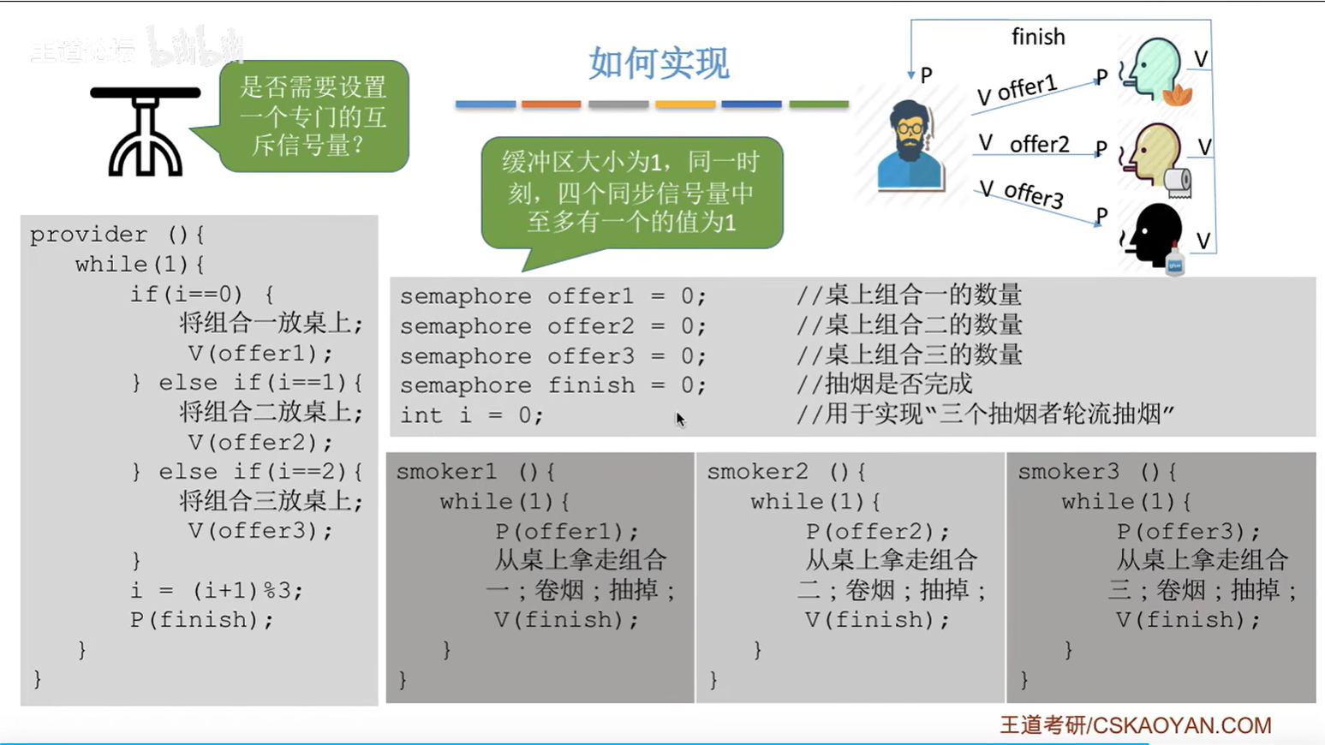

Slide 48
Readers-Writers Problem
A data set is shared among a number of concurrent processes
Readers – only read the data set; do not perform any updates
Writers – can both read and write
Requirements
allow multiple readers to read at the same time
only one single writer can access shared data at the same time
if a writer is writing to the file, no reader may read it
Several variations of how readers and writers are treated
Notes:
允许多个读者同时阅读
只有一个作者可以同时访问共享数据
如果作者正在写入文件，则任何读者都不能读取它

Slide 49
Readers-Writers Problem Variations
First variation
no reader should wait for other readers to finish simply because a writer is waiting（读者不应该等待一个正在等待其他读者释放资源的作者）
readers have priority
Second variation
if a writer is waiting to access the object, no new readers may start reading（如果作者正在等待访问，新来的读者都不能访问）
writers have priority
Notes:
First variation：

Slide 50
Difference between P-C & R-W
Readers do not modify shared data
Readers do not compete with each other
Readers and Writers do not need to test FULL or EMPTY
No synchronization

Slide 51
Identify Race Condition (1)
Shared Data
lock = 1;
reader
writer
do{
wait(lock);
read();
signal(lock);
}while(true);
do{
wait(lock);
write();
signal(lock);
}while(true);
Problem?
Notes:
New readers need to wait
多个读者无法同时read

Slide 52
First R-W: Add Reader Count
reader
lock = 1;
writer
do{
if(reader_count == 0)
wait(lock);
reader_count++;
read();
reader_count--;
if(reader_count == 0)
signal(lock);
}while(true);
do{
wait(lock);
write();
signal(lock);
}while(true);
Problem?
Notes:
Reader_count++: race condition
当多个读者同时执行到 if (reader_count == 0) 语句时，会都wait，但不一定会都同时又进入下面的临界区signal。
加mutex就能保证只有一个读者能通过if (reader_count == 0) 进入临界区

Slide 53
First Readers-Writers Problem
Semaphore rw_lock initialized to 1
Integer reader_count initialized to 0
Semaphore rc_lock initialized to 1
reader
do{
wait(rc_lock);
if(reader_count == 0)
wait(rw_lock);
reader_count++;
signal(rc_lock);
read();
wait(rc_lock);
reader_count--;
if(reader_count == 0)
signal(rw_lock);
signal(rc_lock);
}while(true);
do{
wait(rw_lock);
write();
signal(rw_lock);
}while(true);
Writer
Notes:
Rc_lock是互斥锁，防止同时访问reader_count
第一个reader会等待并获取文件锁，后面的都不用；当最后一个reader离开后，才会signal文件锁，此时writer才能获得文件锁。

Slide 54
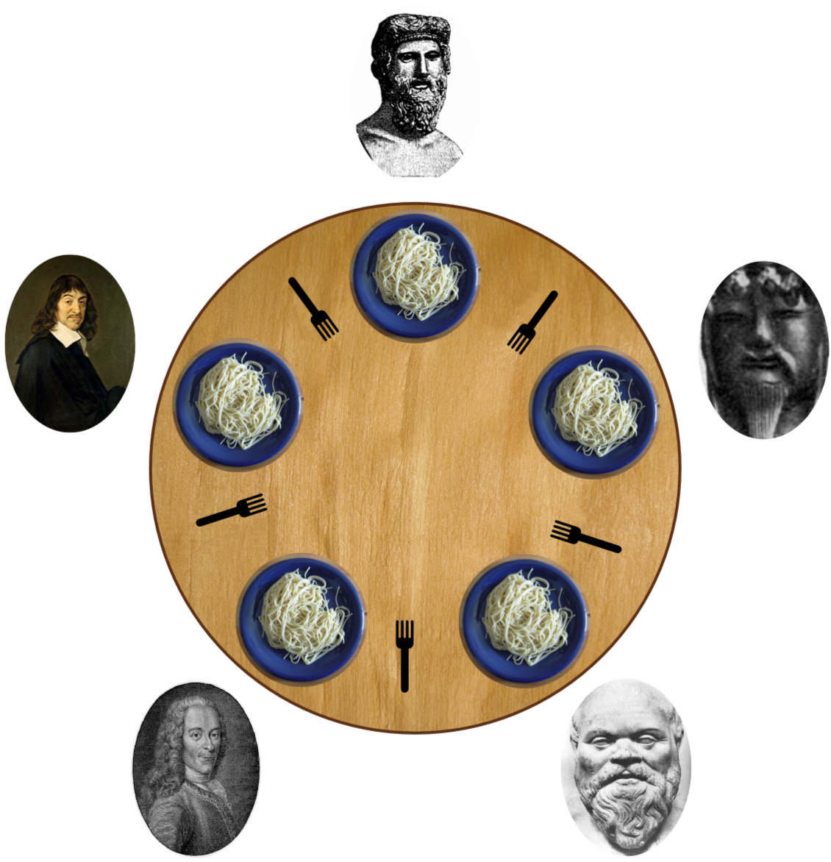
Dining-Philosophers Problem
https://en.wikipedia.org/wiki/Dining_philosophers_problem

Slide 55
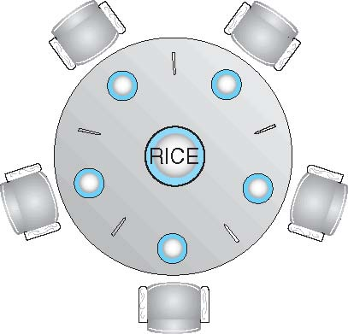
Dining-Philosophers Problem
Philosophers spend their lives thinking and eating
Don’t interact with their neighbors, occasionally try to pick up 2 chopsticks, one at a time, to eat from bowl
Need both to eat, then release both when done
Pick up the two chopsticks that are closest to her/him
She/he cannot pick up a chopstick that is already in the hand of a neighbor
Notes:
同时拿起了左边的筷子
也就是卡旁边拿筷子的人的timing

Slide 56
Dining-Philosophers Problem Algorithm
The structure of Philosopher i
do {
wait ( chopstick[i] );
wait ( chopstick[(i + 1) % 5] );
// eat
signal ( chopstick[i] );
signal ( chopstick[(i + 1) % 5] );
// think
} while (TRUE);
What is the problem with this algorithm?
Semaphore chopstick [5] initialized to 1
Notes:
wait ( chopstick[i] );之后别的进程可以趁机提前wait ( chopstick[(i + 1) % 5] );
那么本进程就真的开始wait了

Slide 57
Possible Remedies
Allow at most four philosophers to be sitting simultaneously at the table.
No deadlock
Allow a philosopher to pick up her chopsticks only if both chopsticks are available (to do this, she must pick them up in a critical section).
No deadlock
Use an asymmetric solution—that is, an odd-numbered philosopher picks up first her left chopstick and then her right chopstick, whereas an even numbered philosopher picks up her right chopstick and then her left chopstick.
No deadlock

Slide 58
The End

Slide 59
Liveness
Liveness refers to a set of properties that a system must satisfy to ensure that processes make progress during their execution life cycle.
Deadlock: A situation in which two or more processes are unable to proceed because each is waiting for one of the others to do something.
Livelock: A situation in which two or more processes continuously change their states in response to changes in the other process(es) without doing any useful work
Starvation: A situation in which a runnable process is overlooked indefinitely by the scheduler; although it is able to proceed, it is never chosen.

Slide 60
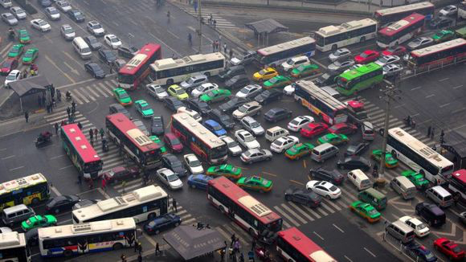
Deadlock

Slide 61
Livelock

Slide 62
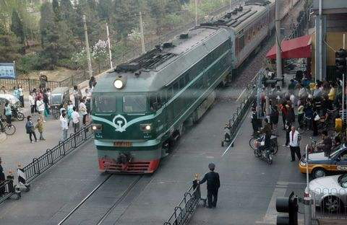
Starvation

Slide 63
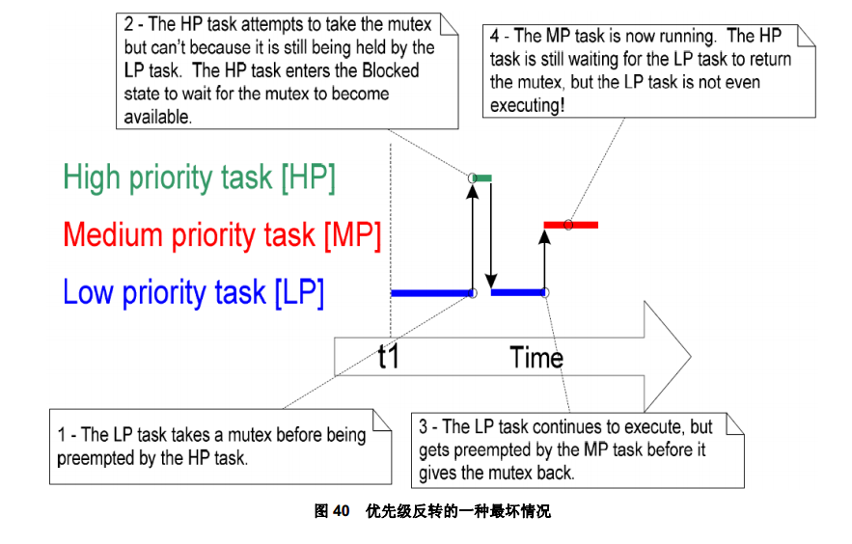
Priority Inversion

Slide 64


Example
Priority inheritance

